Slide 1
August Club News

Slide 2
HAS Monthly Activities
Culloden 300
Belladrum Tartan Heart Festival
Summer Astrophotography Challenge
Doors Open Day 2019

Slide 4
Culloden 300
The National Trust for Scotland has launched a public consultation which aims to ensure the long-term protection of Culloden Moor, the site of the 1746 battle
As part of their consultation they held sessions at the NTS Visitor Centre, hosted by Operations Manager Raoul Curtis-Machin
Pauline Macrae, Pat Escott, Dave Davidson, and myself attended on behalf of HAS
We were able to glean an insight into possible alternative developments and their impact on the area, and, of course, on our long-term capability to observe the night sky
We contributed, in writing (postcards in a box), our concerns and also constructive criticism & solutions if/when these developments are progressed

Slide 6
Belladrum Tartan Heart Festival
Belladrum’s annual music festival (Thu, Fri, Sat: 1-3 Aug) was sporting a Science Fiction theme
They wanted to counterpoint the fiction with Science Fact
At very short notice (one month!!!) they asked us if we could contribute to their Science Arena (“The Belladrum Boffinarium”) in the Walled Garden
We, of course, said “Yes” and got our proverbials in gear and got on with the task of organising & delivering a Pop-Up Solar Observatory & Display stand

Slide 7
Belladrum Boffinarium
HAS Team
Pauline Macrae
Dave Davidson
Trina Shaddick
Gerry Gaitens
Eric Walker

Slide 8
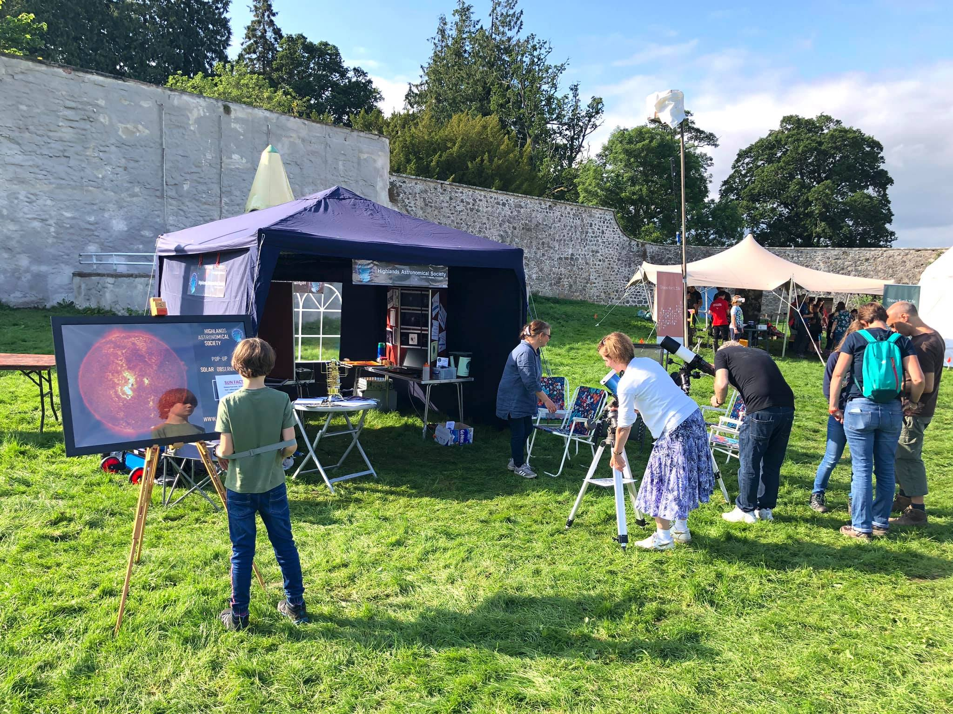
HAS Pop-Up Solar Observatory & Display Stand (Day 1)

Slide 9
HAS Pop-Up Solar Observatory & Display Stand (Day 1)

Slide 10
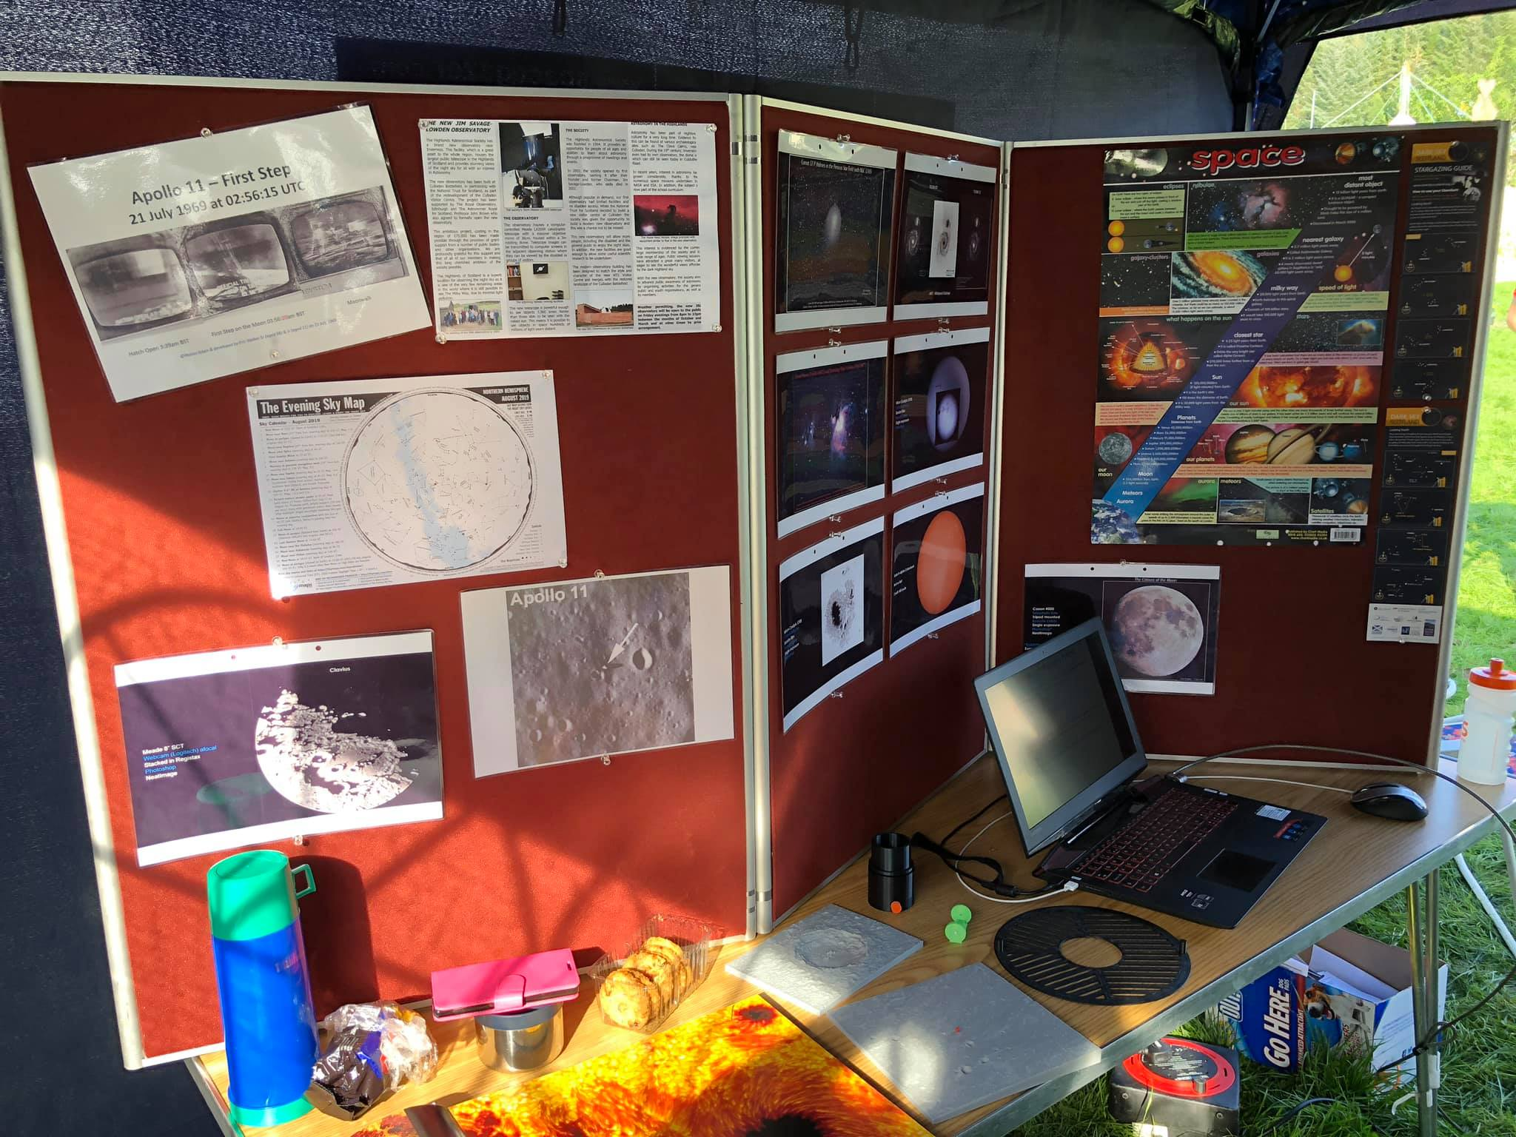
HAS Pop-Up Solar Observatory & Display Stand (Day 1)

Slide 11
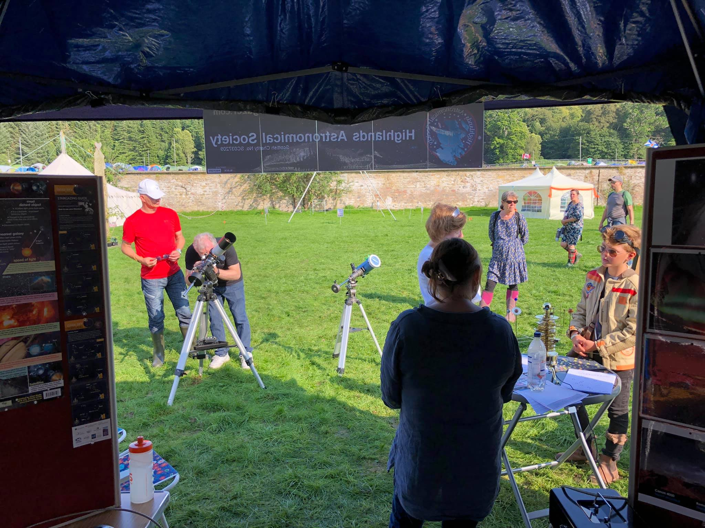
HAS Pop-Up Solar Observatory & Display Stand (Day 1)

Slide 12
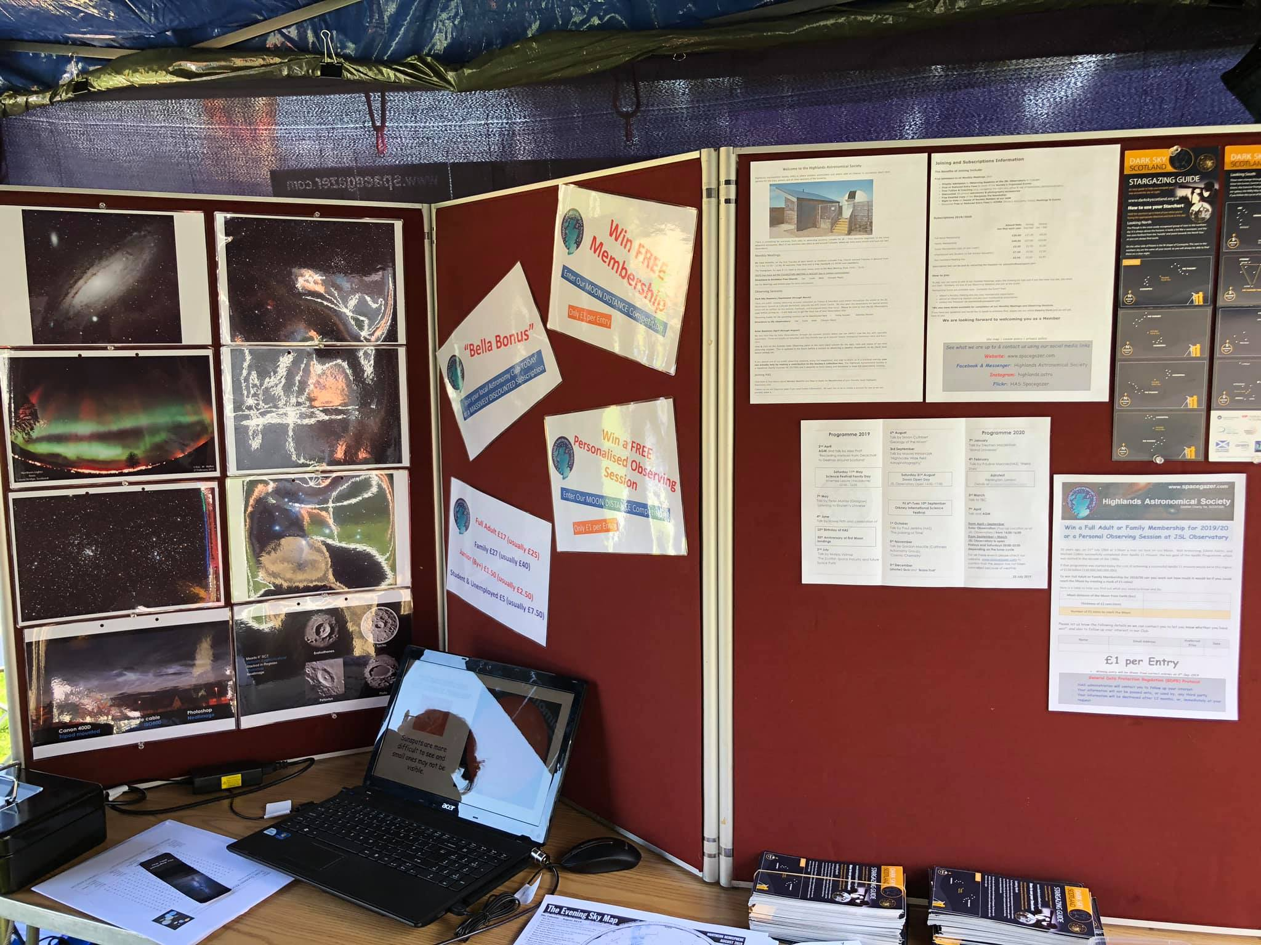
HAS Pop-Up Solar Observatory & Display Stand (Day 1)

Slide 13
HAS Pop-Up Solar Observatory & Display Stand
(Day 2)
A very sunny & busy day for us on our second day. Even had queues waiting to look through the scopes
Middle photo courtesy of Belladrum Tartan Heart Festival

Slide 14
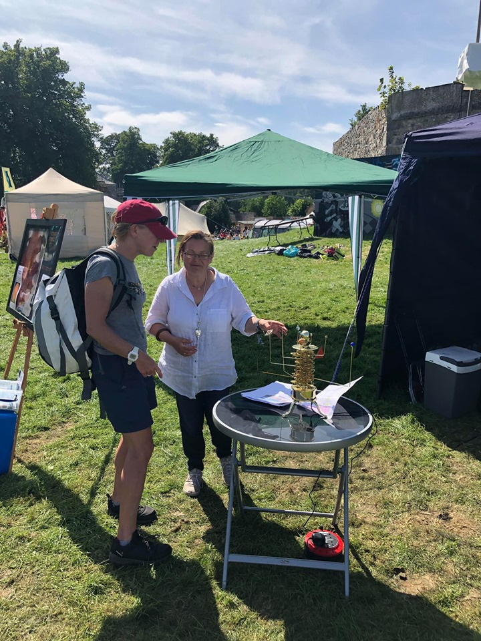
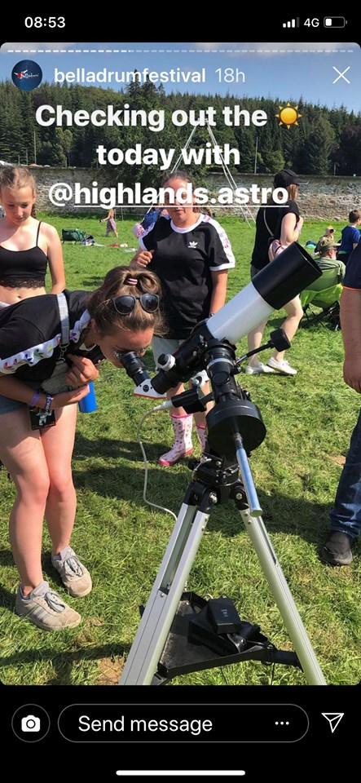
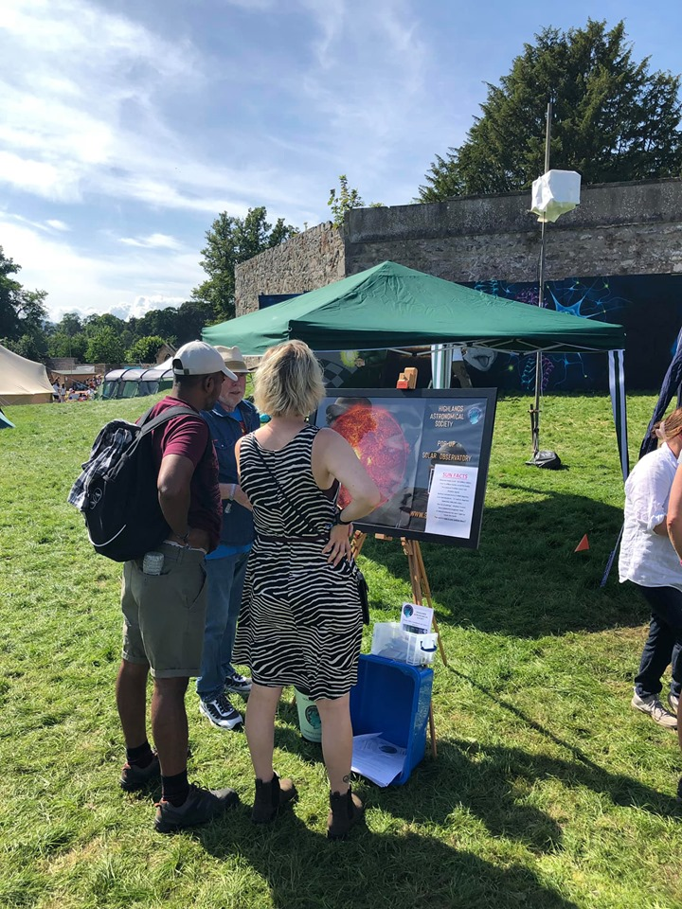
HAS Pop-Up Solar Observatory & Display Stand (Day 2)

Slide 15
HAS Pop-Up Solar Observatory & Display Stand (Day 3)
Excellent last day at Belladrum Tartan Heart Festival
Sun was out, granulation on Sun’s surface, and three prominences to choose from
Fantastic to see so many people interested in Space, our Sun, and astronomy in general. I reckon we’ve had 1000+ people looking through our scopes, our orrery, and display stand over the past three days
Hopefully Bella will be running a Science Arena next year. We’d be delighted to come back!
☀️🔭📷🤓😎👍🏻

Slide 16
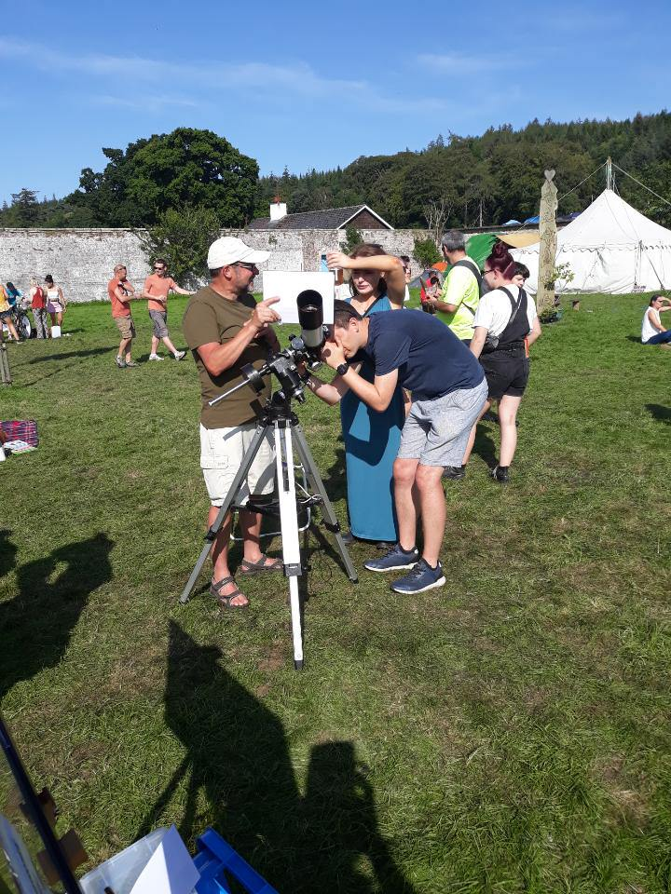
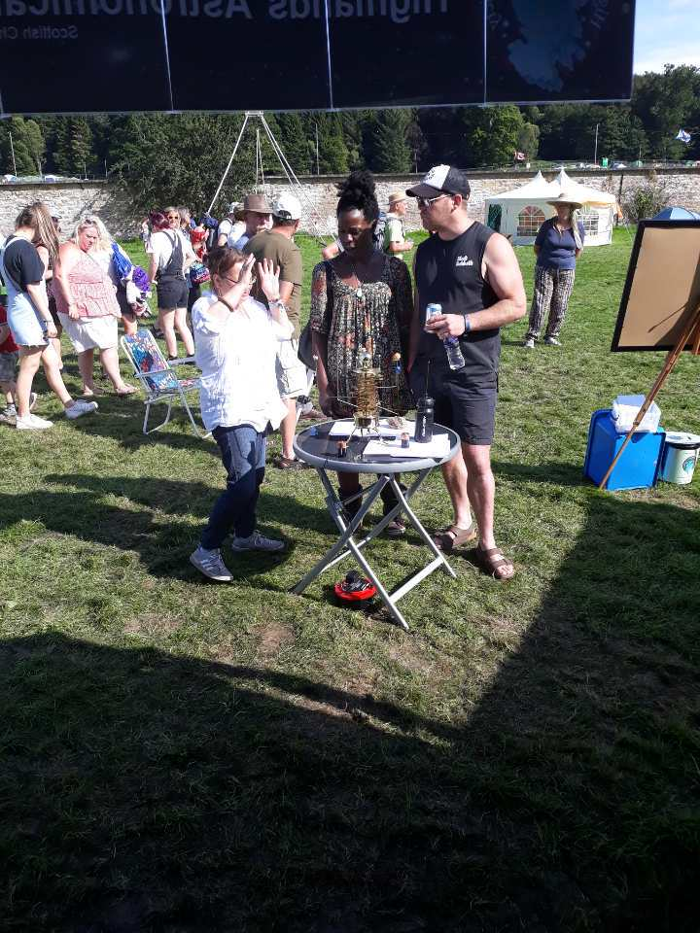
HAS Pop-Up Solar Observatory & Display Stand (Day 3)

Slide 17
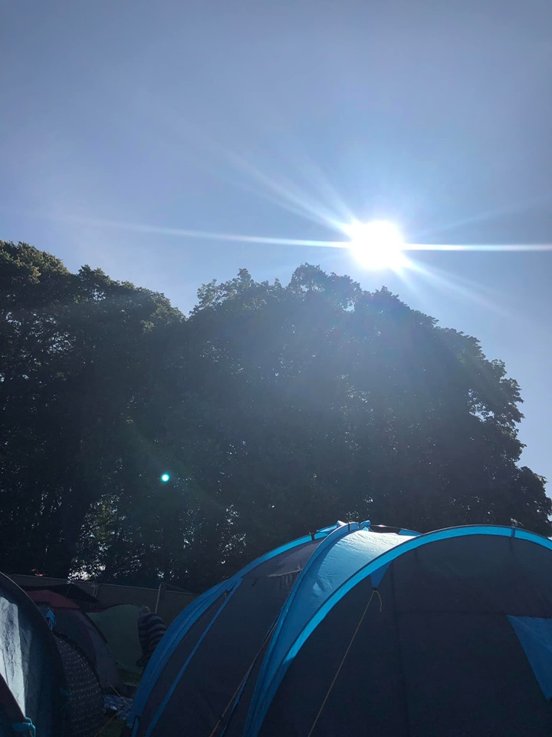
HAS Pop-Up Solar Observatory & Display Stand
Early Morning
(Very) Late Night

Slide 18
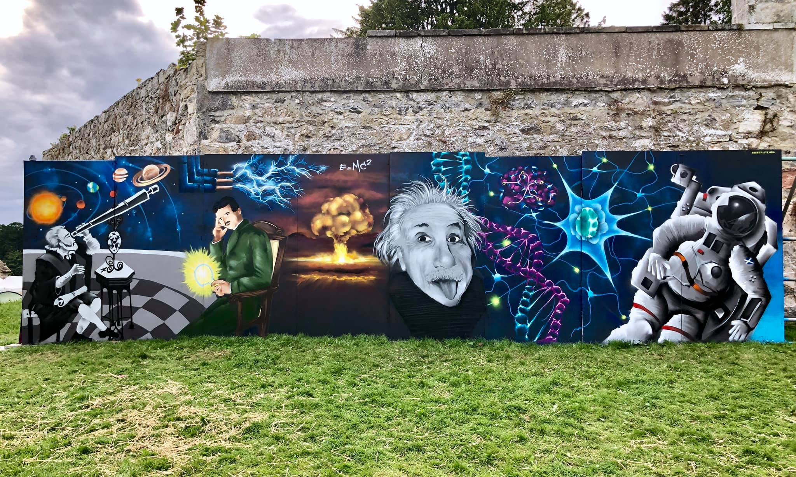
HAS Pop-Up Solar Observatory & Display Stand

Slide 20
Summer Astrophotography Challenge
Noctilucent Clouds
Partial Lunar Eclipse

Slide 22
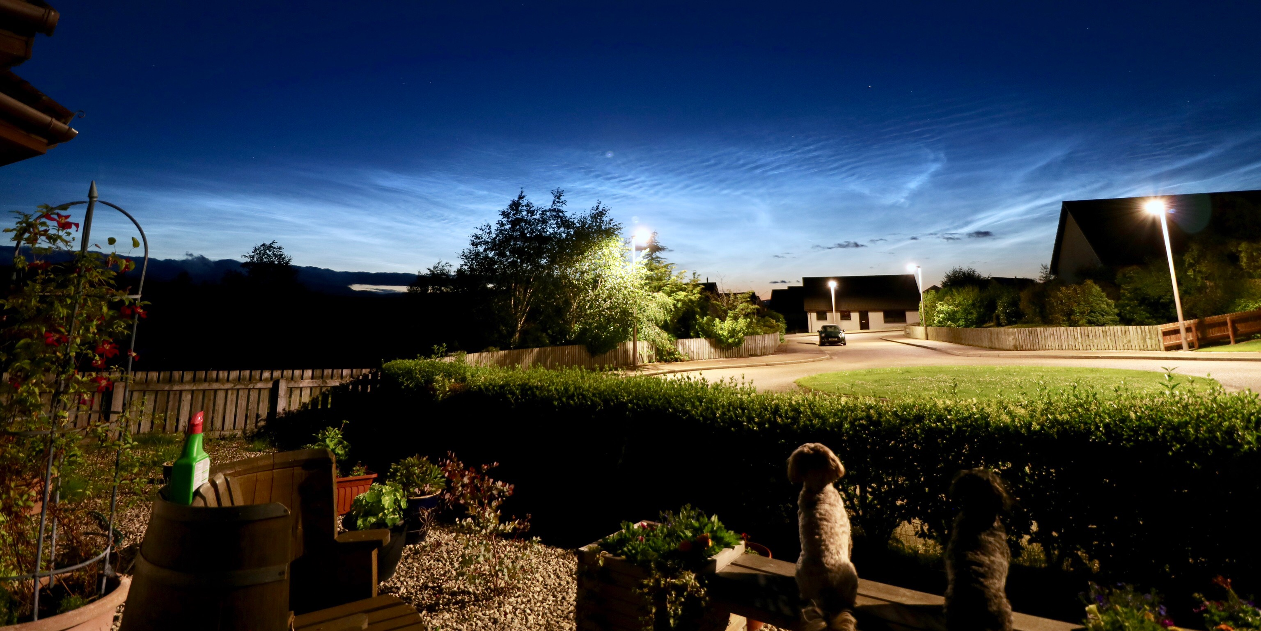
Noctilucent Clouds
14 July 2019 0130h BST ©Eric W Walker

Slide 23
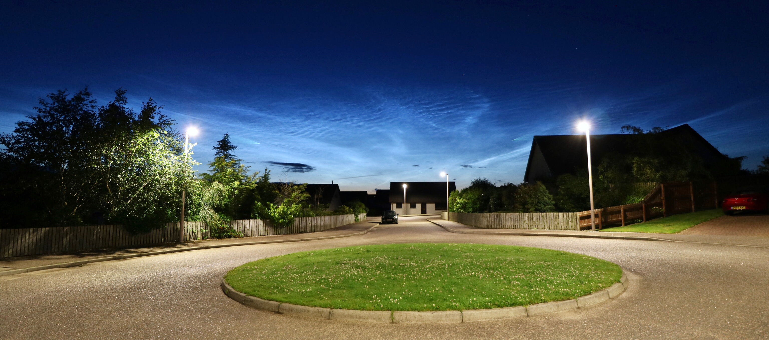
Noctilucent Clouds
14 July 2019 0130h BST ©Eric W Walker

Slide 24
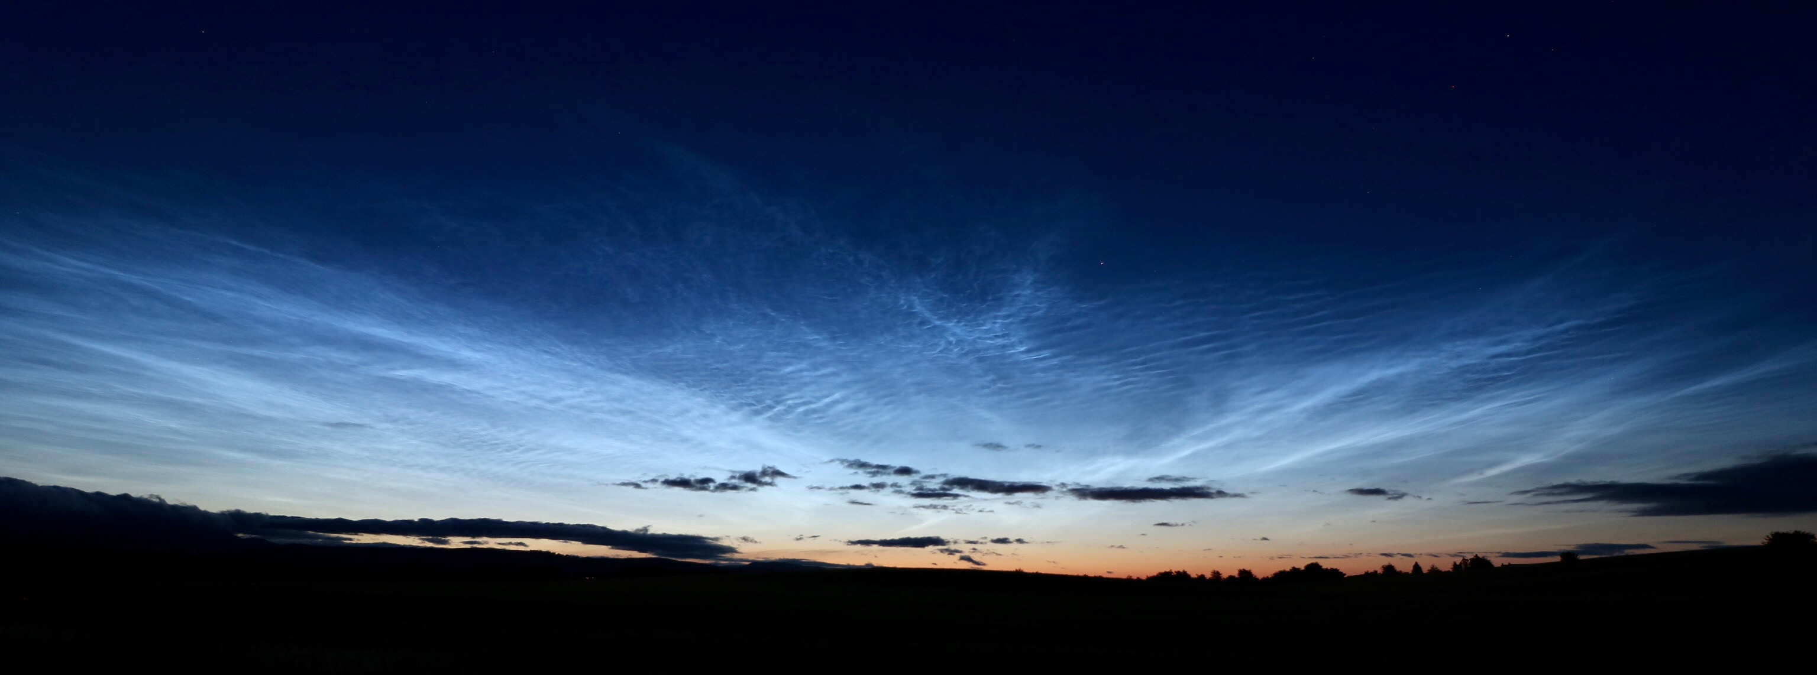
Noctilucent Clouds
14 July 2019 0130h BST ©Eric W Walker

Slide 26
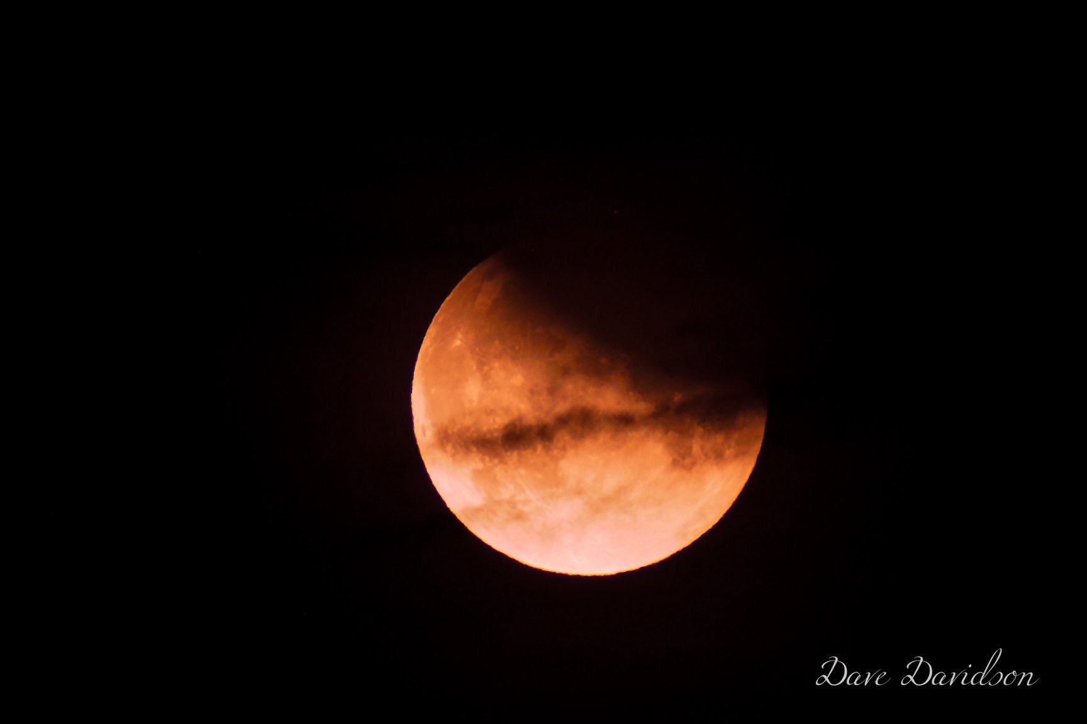
Partial Lunar Eclipse

Slide 27
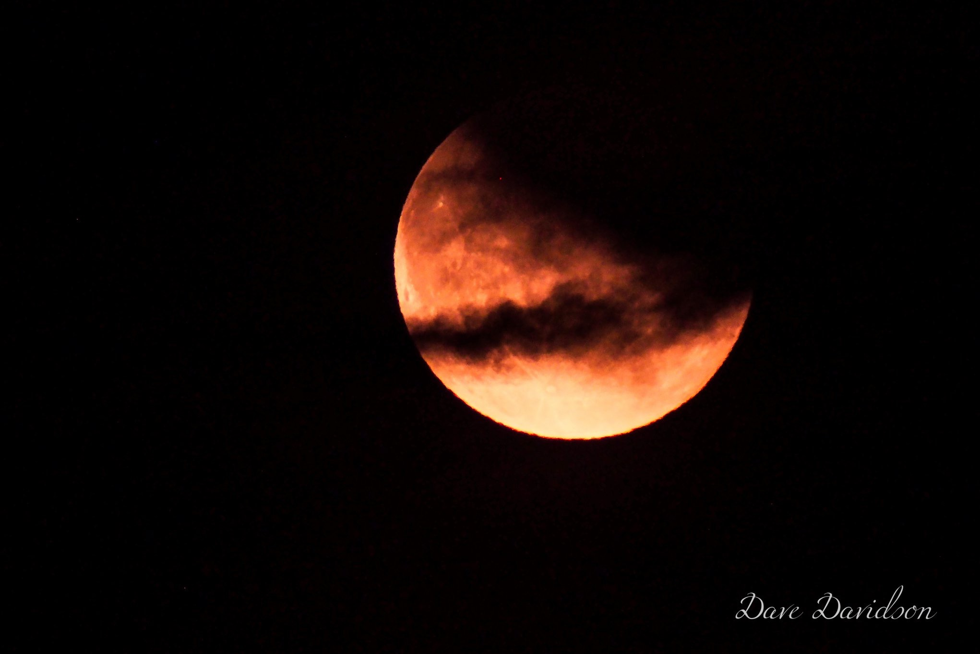
Partial Lunar Eclipse

Slide 28
Summer Astrophotography Challenge
Dave’s next pic received over 6,200 Post Likes, and 500+ Reactions, Comments, & Shares on our Facebook Page – HAS best-performing post by far!
It drew in an additional 40 people to Like our FB Page – this means 40 more people have requested they see our FB social media publications as soon as they are published
BBC Scotland Website Editor asked if they could publish it on their “Your pictures of Scotland” Weekly Gallery – HAS, of course, agreed!

Slide 29
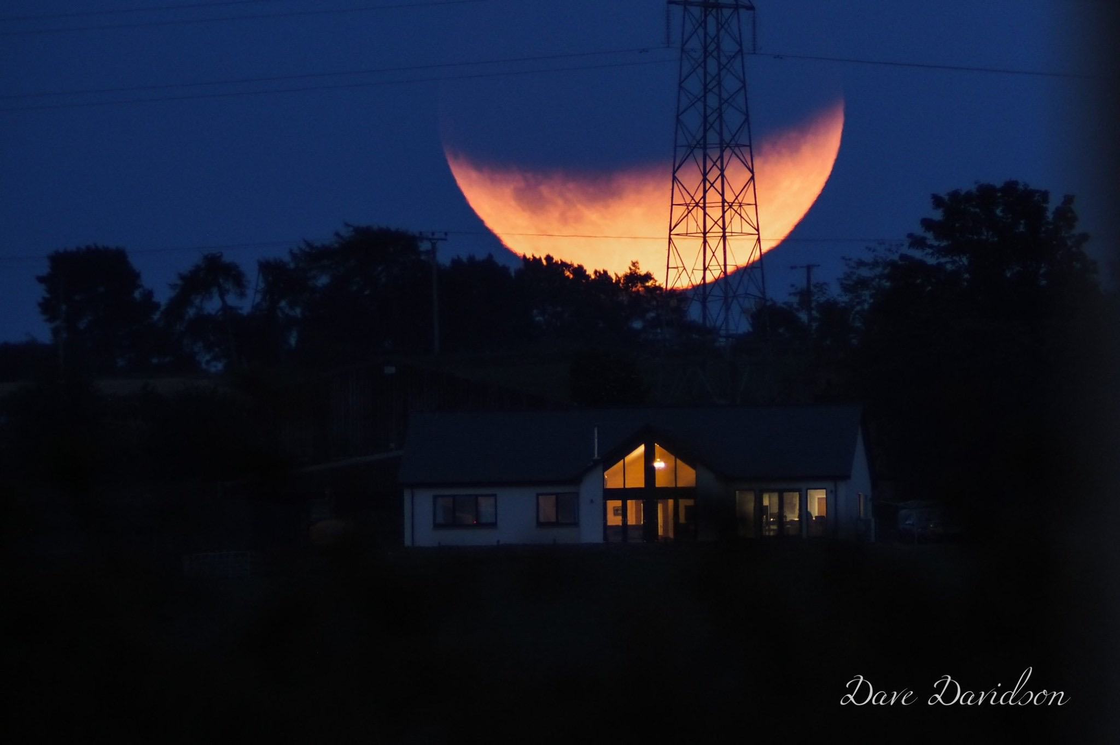
Partial Lunar Eclipse

Slide 31
Doors Open Day 2019
Saturday 31st August from 2pm until 5pm
Urgently need Club Members to help out
1pm until 5pm or 6pm
Doors Open Day publicity is now online and being distributed in pamphlets
HAS publicity will begin in our social media in a fortnight

Slide 32
Social media links
Website: www.spacegazer.com
Facebook & Messenger: Highlands Astronomical Society
Instagram: highlands.astro
Flickr: HAS Spacegazer

