Slide 1
Development Officer
In post 21 July 2014
LDCI

Slide 2
LDCI
In the beginning
Found office
Met with directors
Archived old files
Familiarised self with Lairg & District Community Initiative
Sorted filing cabinets
Sourced stationery
E-mailed members
Tour of village
Looked at previous minutes
Prepared petty cash/spreadsheets
Completed forms
Prepared amples of stationary
Researching logos
Got phone fixed
Sorted out files on laptop
Designed and developed essential paperwork
Timesheet, Holiday form, expenses form

Slide 3
LDCI
Events I have attended
Met with the Kyle of Sutherland Trust
Met with Highlands & Islands Enterprise
Attended Third Sector Conference
Attended Rural Parliament Initial Event
Visited Strathpeffer Community Fitness Room

Slide 4
LDCI
Projects
New Local Telephone Directory
Working through local numbers for residents and businesses
Information letter sent to businesses offering advertising space
Negotiating a good deal for publishing
Sponsorship secured from Migdale Smolt Ltd and Migdale Transport Ltd
Aim to have the final publication ready for end of October 2014

Slide 5
LDCI
Projects
Had a small stall at Crofter’s Show
Despite the wind we managed to keep our Gazebo pinned to the ground
Had a tombola stall, nail in the bale and Logo competition
Proceeds of £112 were given to Lairg Nursery

Slide 6
LDCI
Projects
NEW LDCI WEBSITE
Began to design new website
After attending Third Sector Conference, there is potential for LDCI to have a new website designed and created by a professional at no cost
Meeting to attend on 07/10/14 to follow this up

Slide 7
LDCI
Railway Path
Had several discussions with people regarding path
Currently working on proposal to take forward to Hi-Trans, Network Rail and Highland Council
Dependent on securing funding

Slide 8

LDCI
Fitness Room
Currently assisting Alasdair Marshall with research in how to take this project forward
Hoping to secure funding for equipment in the very near future

Slide 9
LDCI
Church Hill Path
Arranged a volunteer group to assist with path clear up
1st Day was 20 September 2014
14 Volunteers in total
Worked from 10 am
Lunch was provided
Have received a quote for upgrade of path and currently working at how we can fund the path to be fixed

Slide 10
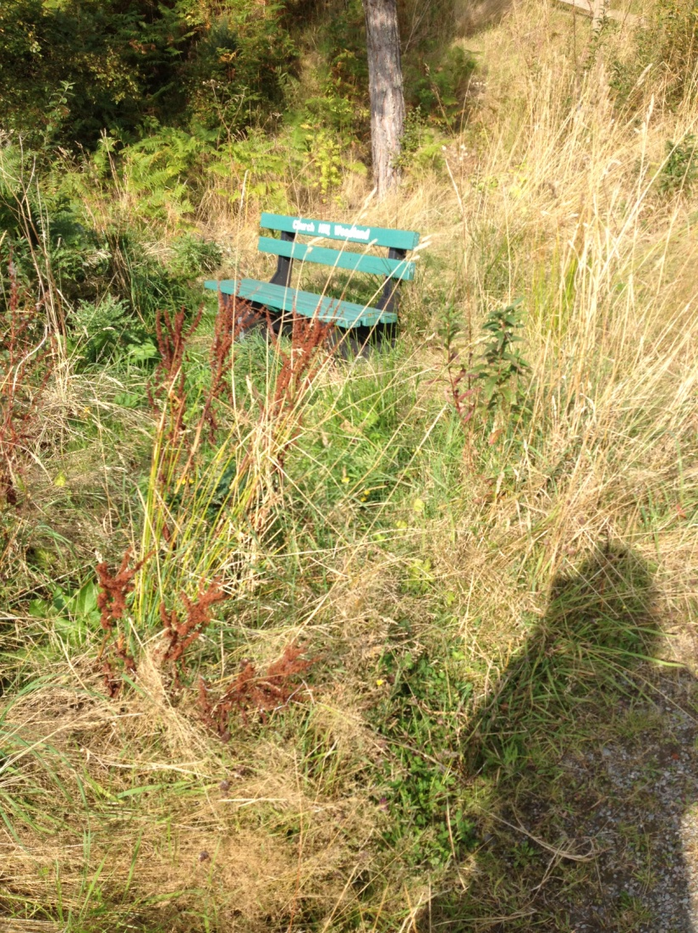
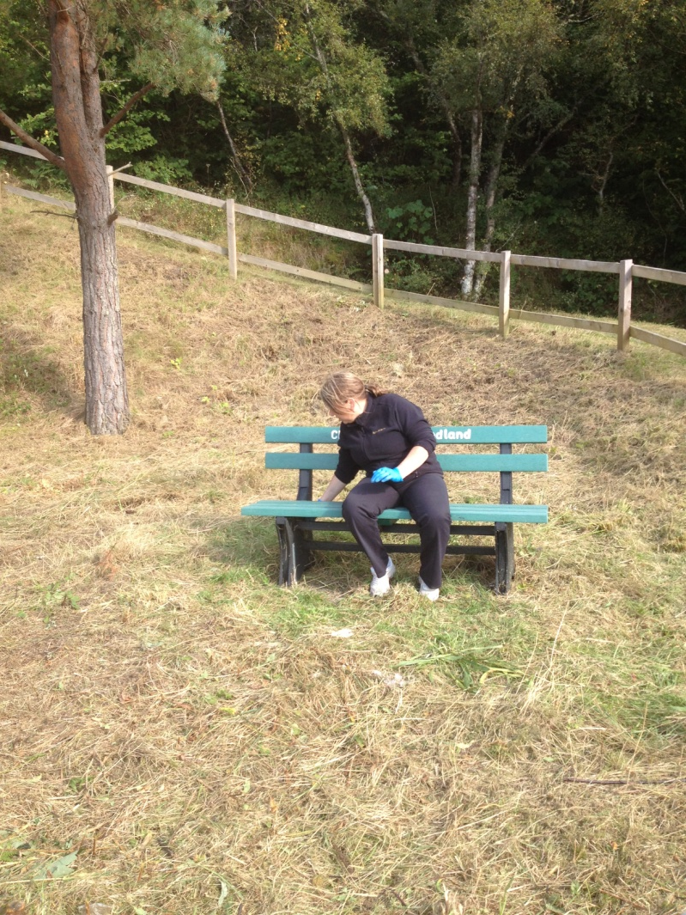
LDCI
Church Hill Path Volunteer Day
Before
After

Slide 11
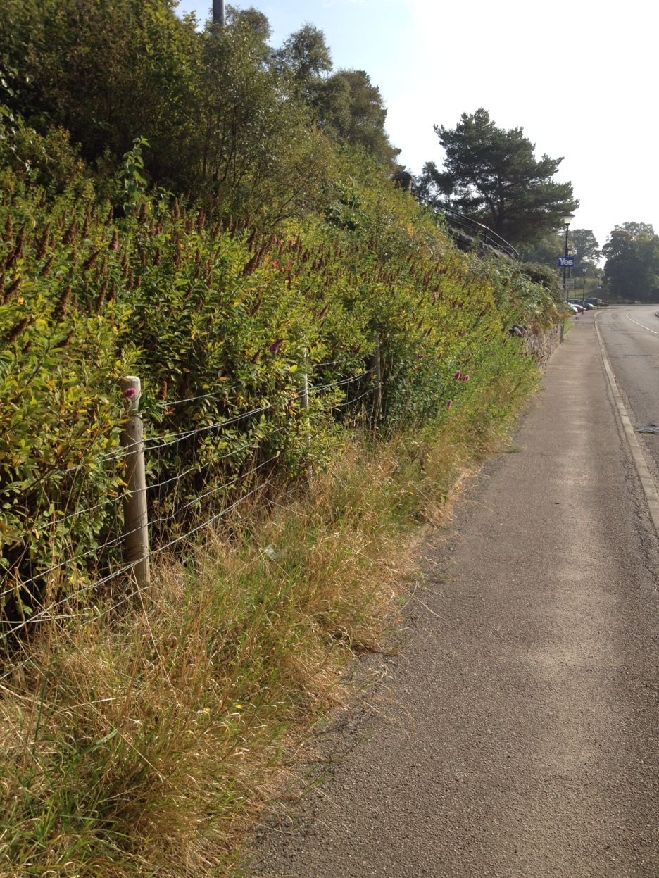
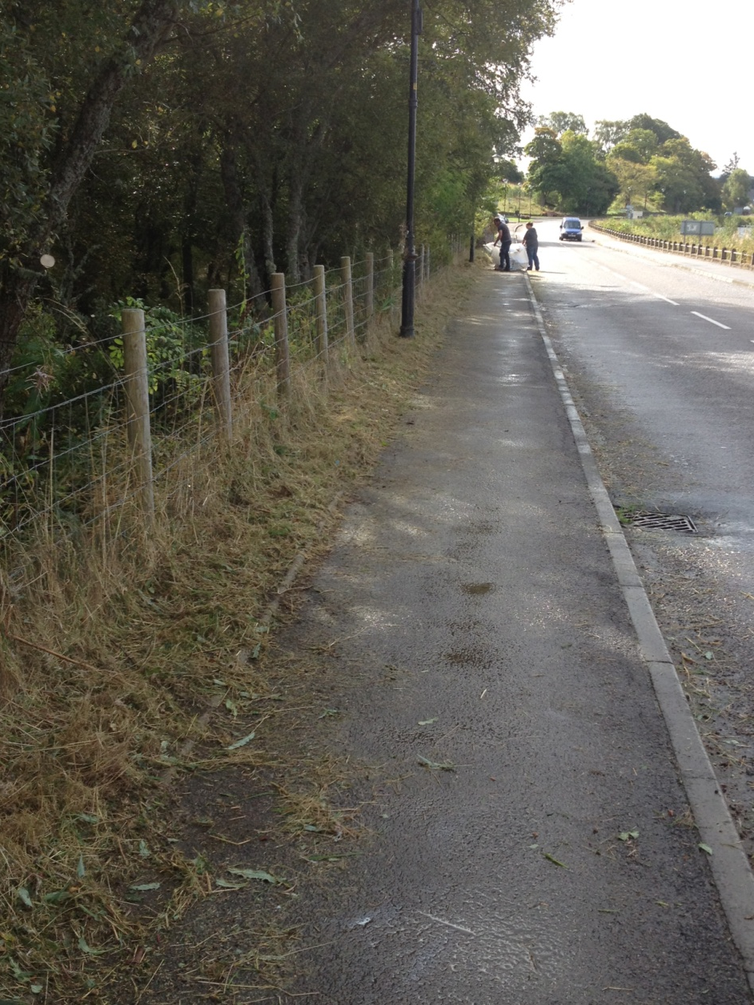

Slide 12
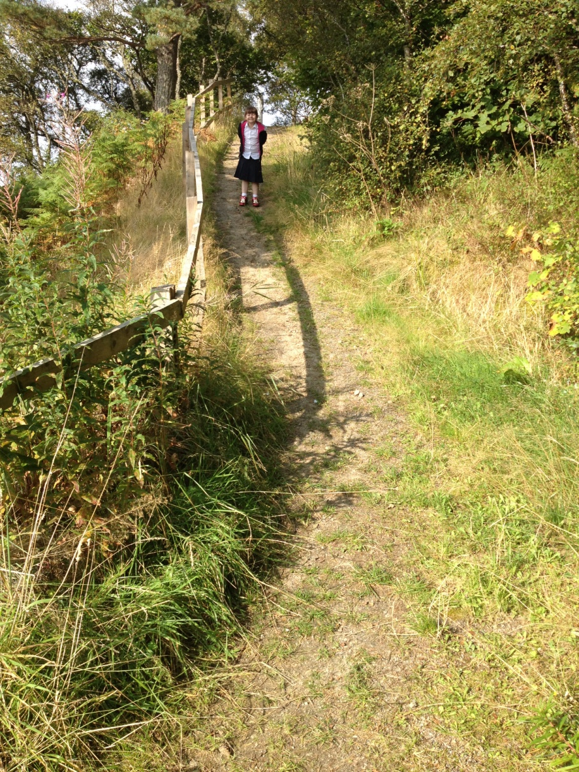
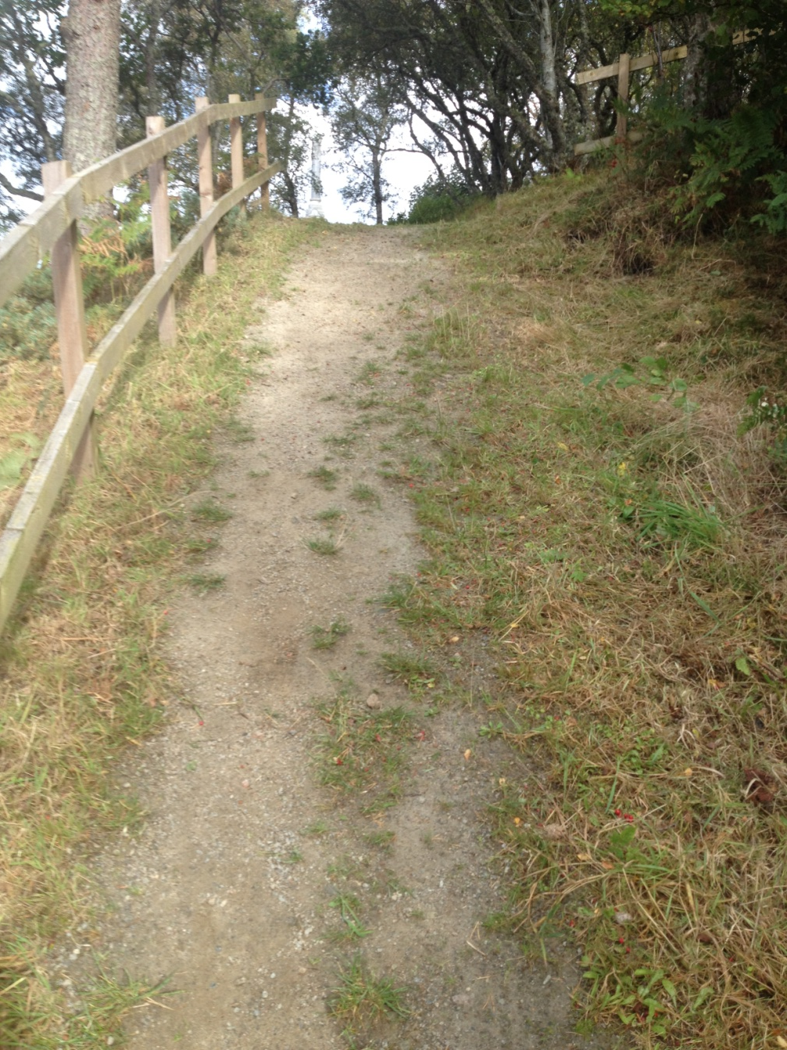

Slide 13
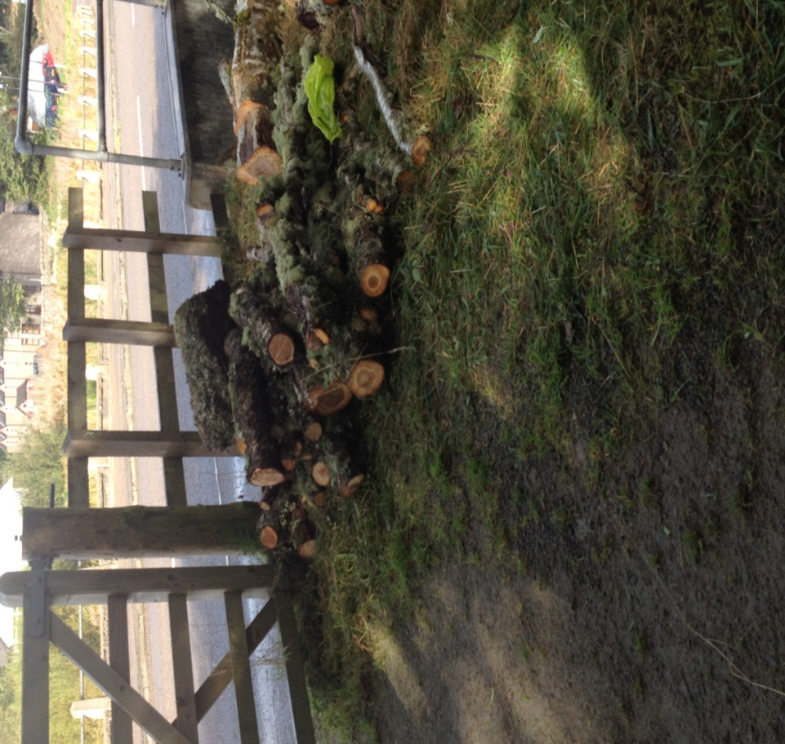
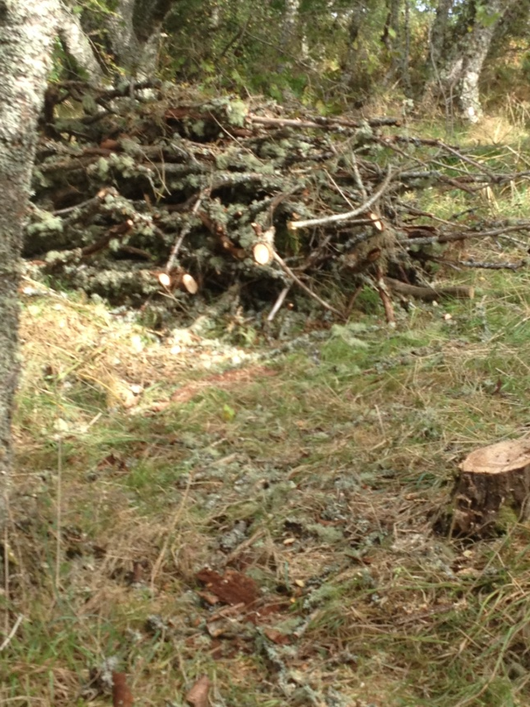
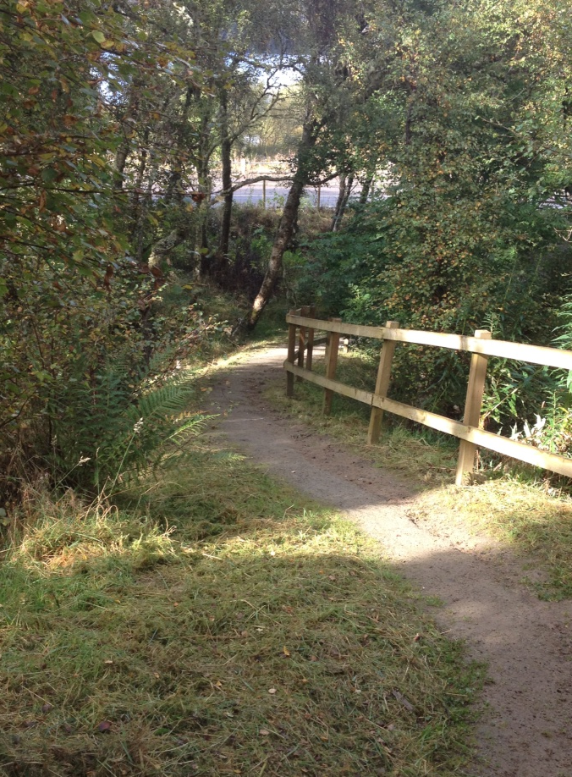
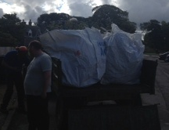

Slide 14
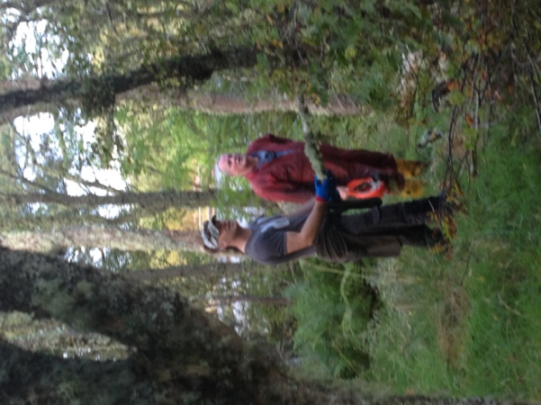
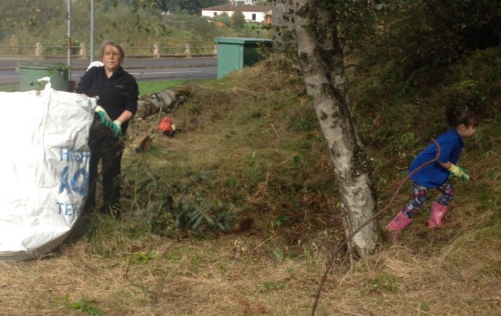
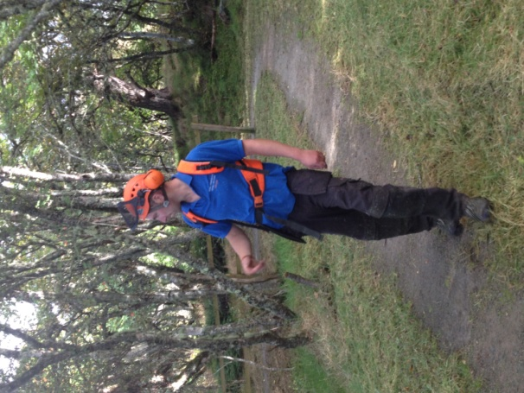
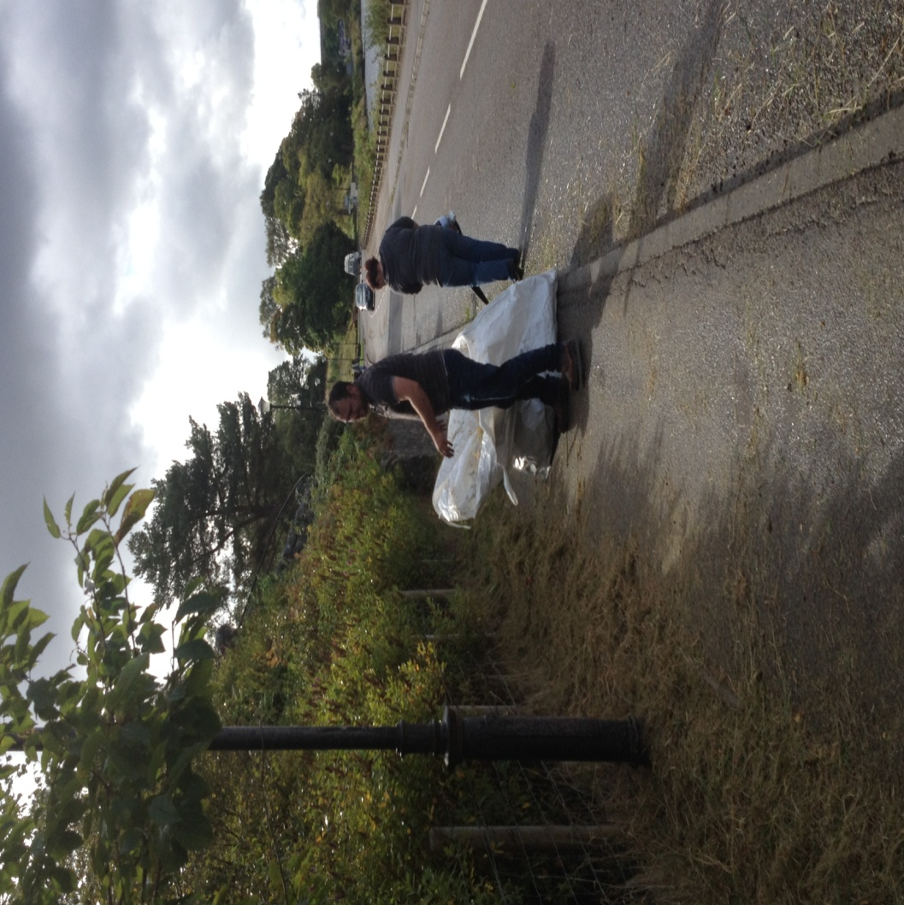
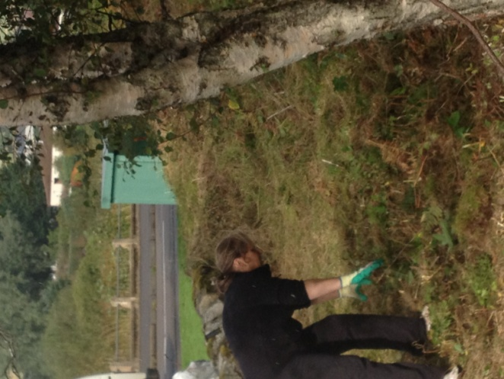
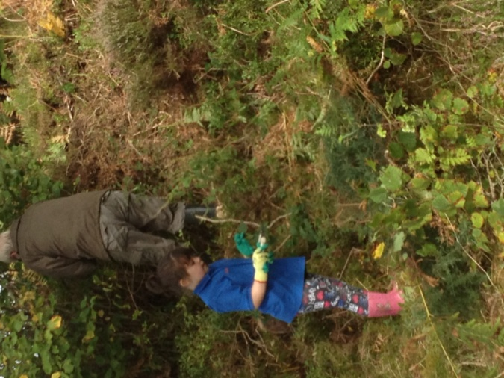
CHURCH HILL PATH VOLUNTEERS

Slide 15
LDCI
On behalf of the LDCI, I would like to thank:
our volunteers with their assistance with Church Hill Path
The people who designed the Walks around Lairg Leaflet
Everyone for their continued support
On a personal note I would like to thank everyone for my warm welcome to Lairg

Slide 16
Development Officer
Please feel free to contact me:
E-mail: projectofficer@lairginitiative.co.uk
Telephone: 01549 402 843
Call along to see me at Lairg Community Centre

