Slide 1
Lairg and District Community Initiatives
Annual General Meeting
1 September 2015
Development Officer’s presentation

Slide 2
Lairg and District Community Initiatives 2014 - 2015
Projects
Partnership working
Meetings

Slide 3
Lairg and District Community Initiatives 2014 - 2015
PROJECTS
Ring Fenced Funding
Donna has secured funding towards Development Officer’s post as well as covering office rent and project costs.
3 years funding from SSE and Robertson Trust

Slide 4
Lairg and District Community Initiatives 2014 - 2015
PROJECTS
Churchill Path
Unfortunately we had two funding applications rejected. Paths for All are now open – we will apply for funding again
Meanwhile we had two clean up days (last one in May) and we’re hoping to gather volunteers for one more in Autumn (all welcomed to help)
James (work experience programme) has done work on benches, gates and fences (sanding and painting)

Slide 5
Lairg and District Community Initiatives 2014 - 2015
PROJECTS
Railway Footpath
Problems identifying who has an authority over the development – Scotrail passed the responsibility to the HC (Road Safety Team)
Donna has done some research as to the actual usage of the footpath. This information is needed to have stronger argument when discussing with the Highland Council but also to be able to apply for funding.
Paths for All and ‘Safe routes to School’ are identified as potential funders.

Slide 6
Lairg and District Community Initiatives 2014 - 2015
PROJECTS
Helicopter Landing Lights
Full funding secured for the lights (£5000) from three sources

Slide 7
Lairg and District Community Initiatives 2014 - 2015
PROJECTS
SSE Resilient Communities Fund
Funding application submitted for the power generator connections in the Community Centre as well as satellite phone in case of an emergency (over £5500) – decision made September 2015
Community Emergency Plan in place
Distributing ‘Support in Emergency’ leaflets for the vulnerable

Slide 8
Lairg and District Community Initiatives 2014 - 2015
PROJECTS
Fitness Room
Funding application submitted – we are now waiting for the response (October 2015)
Further research was conducted as to the best equipment
Initial conversation with the Highland Council and Technogym about a possible agreement – taking over HC leisure centres old equipment or getting the same leasing deal as HC
Funding application to Sport Facilities Fund in progress

Slide 9
Lairg and District Community Initiatives 2014 - 2015
PROJECTS
Social Enterprise which will include:
A village hub for information (events, transport links, local information)
A shop that will provide sales of items made by LDCI volunteers (men’s shed)
An area on the shopfloor offering selling space to local crafters
An opportunity to recycle/upcycle discarded goods (men’s shed)
Provide work experience and volunteering opportunities
Potential employment
Ongoing research – visit made to Employability Orkney, talked to Made in Tain, visits to be arranged to the Boyndie Trust and Ace Recycling
Social Investment Scotland (SIS) workshop about options financing the enterprise
Feasibility study in progress – possibly seeking advice from HISEZ

Slide 10
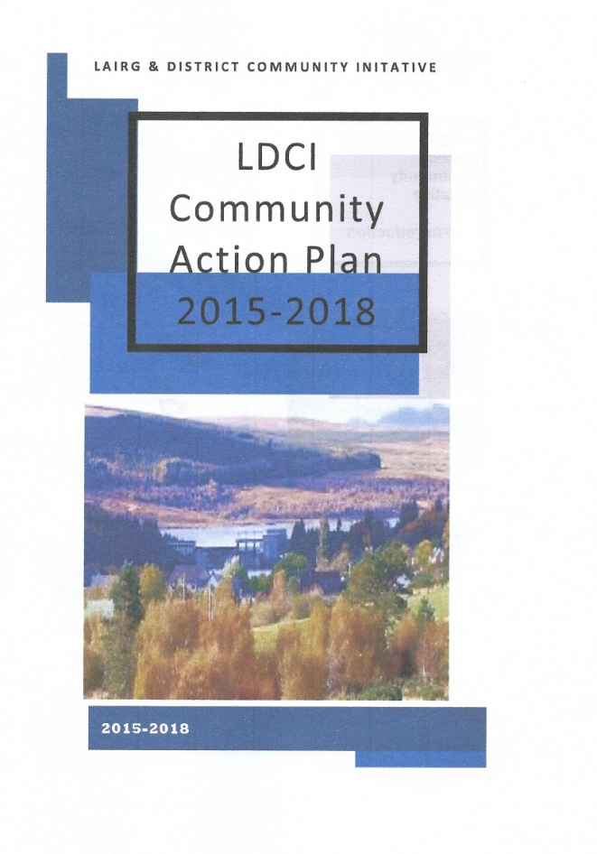
Lairg and District Community Initiatives 2014 - 2015
PROJECTS
Business Plan
LDCI plans for the following three years based on the community preferences

Slide 11
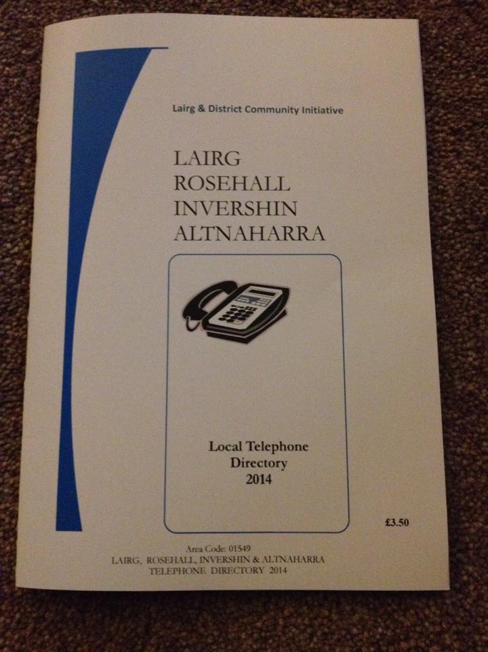
Lairg and District Community Initiatives 2014 - 2015
PROJECTS
Telephone Directory
The Directory has been printed and distributed, however there appear to be some mistakes and omissions made so we are in the process of reviewing the first edition. The updated list of telephone numbers is available in the Post Office for the public to view and make necessary changes.

Slide 12
Lairg and District Community Initiatives 2014 - 2015
PROJECTS
Events
Frozen Disco
Superheroes Disco
Minions Disco
Crofters Show 2014 and 2015
Red Ball Challenge (GALA week)
Winterfest 2015 (funding application submitted)

Slide 13
Lairg and District Community Initiatives 2014 - 2015
PROJECTS
Walks around Lairg
The leaflet for visitors (as well as some locals) has been designed and distributed
Hard copies have been sent to local businesses

Slide 14
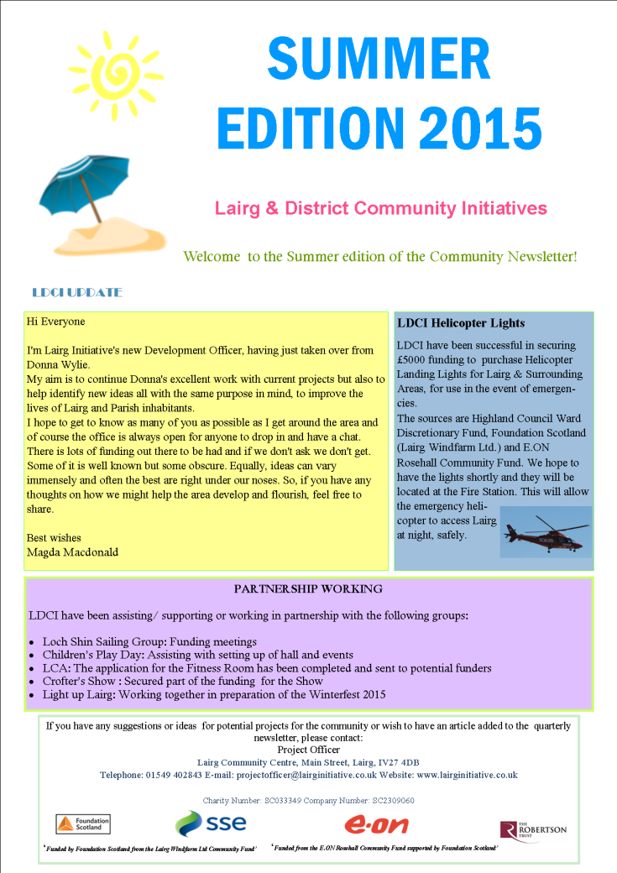
Lairg and District Community Initiatives 2014 - 2015
PROJECTS
Newsletters
Summer Edition was the third newsletter published by LDCI. The Autumn Edition is currently being prepared.

Slide 15
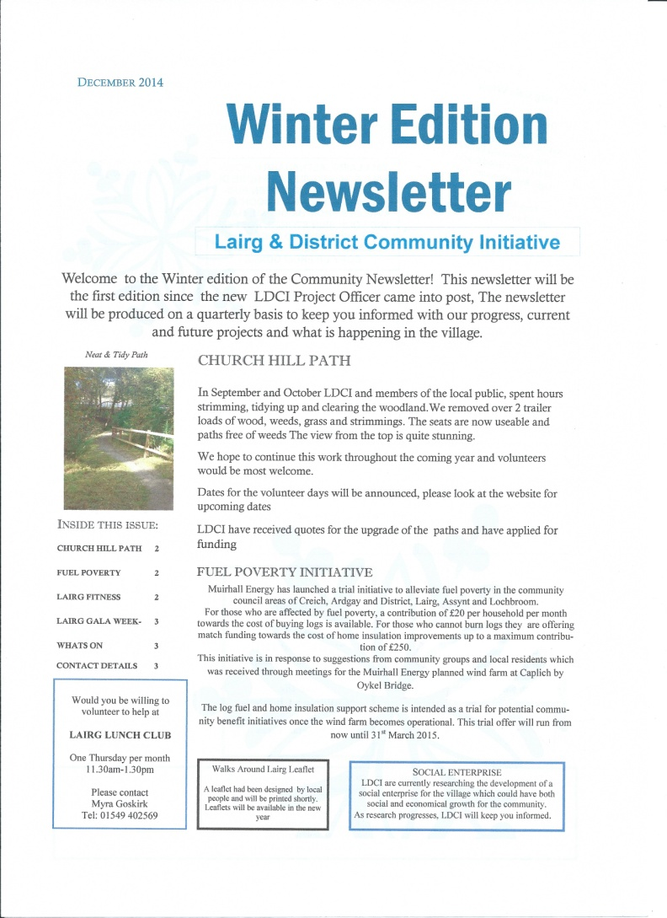
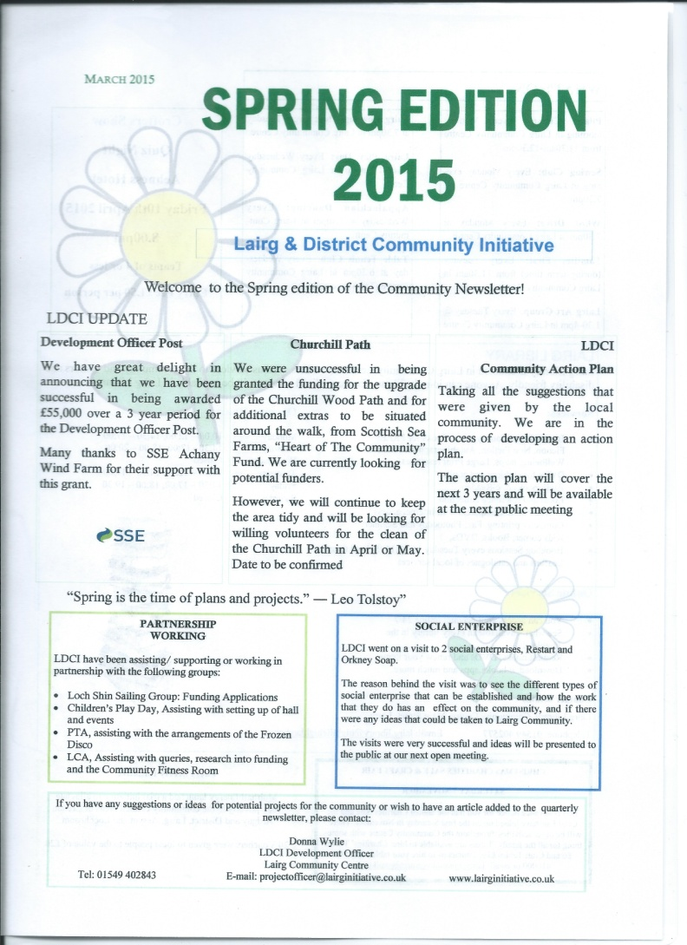
Lairg and District Community Initiatives 2014 - 2015

Slide 16
Lairg and District Community Initiatives 2014 - 2015
PROJECTS
Website/Facebook
Free website has been established, however it is a very difficult to navigate, time consuming tool to use. The research has been done into the future website – a large comprehensive site for the whole community, all community groups and businesses, locals and tourists, where LDCI would just be one of many groups involved and would take a role of the site administrator. Currently waiting for the price of the project then applying for funding.
Facebook page has proved to be a very successful tool. It’s been regularly updated and within a very short period of time we have reached a large number of local people involved in the community events.

Slide 17
Lairg and District Community Initiatives 2014 - 2015
PROJECTS
NEW PROJECTS :
- Community Challenge Fund
Taking over the services provided by the Highland Council (ground maintnance, litter picking, grass cutting, public toilets, garden aid etc.). Very early stage – talking to VGES to organize meeting with the Council. The negotiations with the Council (possibly under freedom of information we can be provided with the information as to the current spending costs)
Application deadline – 6th November
- Community Bus
Flexible service that would include: Dementia -friendly communities, primary school, local sports club, various groups, service to the station, shopping days etc)
Researching similar services across Scotland. Meeting in Helmsdale.
Potential funders.

Slide 18
Lairg and District Community Initiatives 2014 - 2015
PARTNERSHIP WORKING
Loch Shin Sailing Club
Full funding secured for the feasibility study of the future development of the Loch Shin Sailing Club project (£25 000)
The 99 year lease between LDCI and LSSC – currently being prepared by the solicitor
Attending meetings with LSSC mentors

Slide 19
Lairg and District Community Initiatives 2014 - 2015
PARTNERSHIP WORKING
Crofter’s Show
Full funding secured for running the Show this year (£6 000)
Creating advertising posters for the Show
LDCI had a stall at the Show (in 2014 fundraising money for the Nursery, in 2015 for the Winterfest) and a bouncy castle for children

Slide 20
Lairg and District Community Initiatives 2014 - 2015
PARTNERSHIP WORKING
Lairg Community Association
Research and funding application for the Fitness Room
Research and funding application for the power generator connections in the Hall and the satellite phone
Administration work for the Community Centre

Slide 21
Lairg and District Community Initiatives 2014 - 2015
PARTNERSHIP WORKING
Learning Centre
Work experience – providing tasks, work supervision and assessing the progress (12/05/15 – 24/09/15).

Slide 22
Lairg and District Community Initiatives 2014 - 2015
PARTNERSHIP WORKING
Play Days
Assisting the organizers in setting up the Hall
Cooperation during the children’s events (the Discos, Crofters Show etc)

Slide 23
Lairg and District Community Initiatives 2014 - 2015
PARTNERSHIP WORKING
Primary School
Supporting School with the Eco Committee
Fuel Poverty Initiative
Distributing vouchers (£20) for electricity/wood
Highland Hospice
New Christmas lights for the Hospice tree

Slide 24
Lairg and District Community Initiatives 2014 - 2015
MEETINGS
LEADER meetings organised by the HC – recognizing the priority activities for the region that can be funded from LEADER
SIS (Social Investment Scotland) – workshop about funding the social enterprise
SSE workshop – resilient communities programme
Fiona Morrison (SSE) and Carol Elliott (Foundation Scotland) – discussing current and future funding for Lairg
Emergency Plan meeting
Local Energy Scotland – presentation given by Ross Jones about the future windfarm development and potential for community benefit
VGES
Kyle of Sutherland Development Trust
HIE and LSSC – development prospects for the Sailing Club
Local groups (Ferrycroft Visitors Centre, Learning Centre, Lairg History Society, Crofters Show, LCA, etc.)

